Slide 1

SNAKE GAME USING CSS,HTML AND JAVASCRIPT

Slide 2
CONTENTS
Introduction of project
History of snake game
Requirements
Flowchart
Features and about the project
Objective of the project
Code and Output
Future scope of the project
Conclusion
References

Slide 3
Introduction
This project has been built in the following manner.
1.The main structure has been built using html.
2.The styling has been done using css.
3.The main coding of how the should work has been done using js.
We would look into detail about above point in the coming slides

Slide 4
History
Snake is the common name for a video game concept where the player maneuvers a line which grows in length, with the line itself being a primary obstacle.
The concept originated in the 1976 two-player arcade game blockade from gremlin industries, and the ease of implementing snake has led to hundreds of versions (some of which have the word snake or worm in the title) for many platforms.
1982’s Tron arcade game, based on the movie, includes snake gameplay for the single-player Light Cycles segment, cementing A connection between the two.

Slide 5
Snake first appeared in 1997 on the nokia 6110, along with the games logic and memory.
It was programmed by Taneli armanto, a design engineer in nokia.
The concept originated from the 1976 arcade game 'blockade', developed and published by gremlin

Slide 6
Requirements
Software Requirements
Operating System : Any
Application Of Software : Web Browser
Language : Java , CSS , HTML
Hardware Requirements
Hard Disc : Any
Ram : Any
Processor : Any

Slide 7
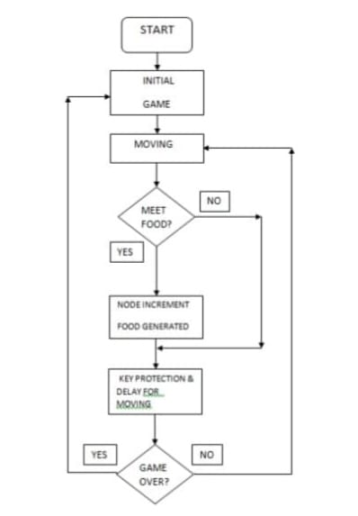
Flowchart

Slide 8
Features and about the project
Currently there is only one option provided which is to Start the game.
The high score is saved in the local storage .
The score section will display the current Score and the High Score .
The Snake position has been set at Centre, so whenever player will start the game, the snake will appear at Centre location every time.
The snake will always appear in black and grey colour in a gradient finish .

Slide 9
Objective of the project
The “snake game” is a game made using Multiple language. This is a game which is quite easy to play. The game is a classic representation of the snake game which appears as an inbuilt game feature in most of the leading mobile handsets like Nokia.
The “snake game” is one of the simplest game concepts ever, and just like Tetris it’s very addictive. There are a lot of variations of this game written in Flash, a relatively easy game to code, with an ability that when keys are pressed in rapid succession they are all registered. This is necessary if you want to have full control of the snake at all times.
The objective of this project is to build a snake game . In this project , the player has to move a snake so it touches the food. If the snake touches itself or the border of the game then the game will over. If it touches the food it gets bigger .

Slide 10
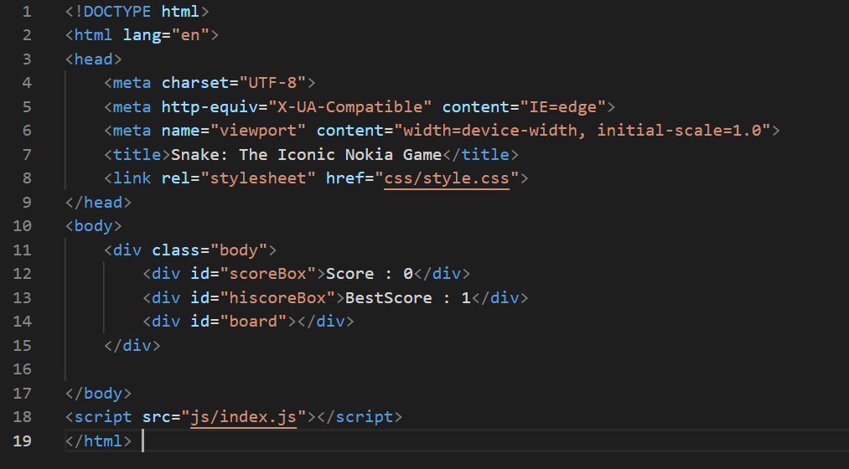
Code files :
1. The Structure

Slide 11
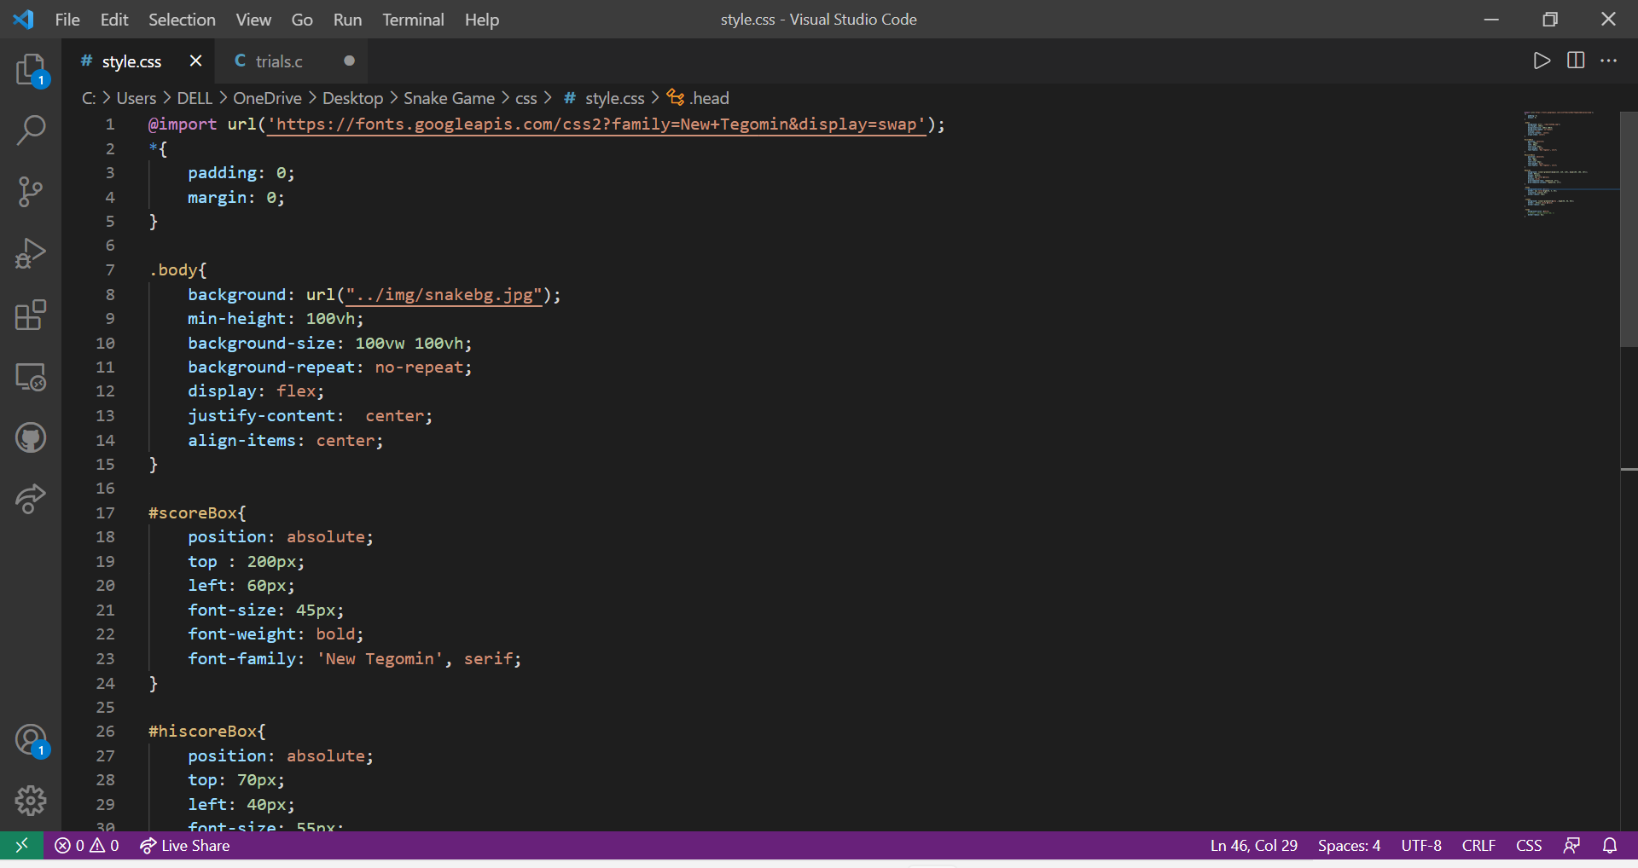
2.STYLING

Slide 12
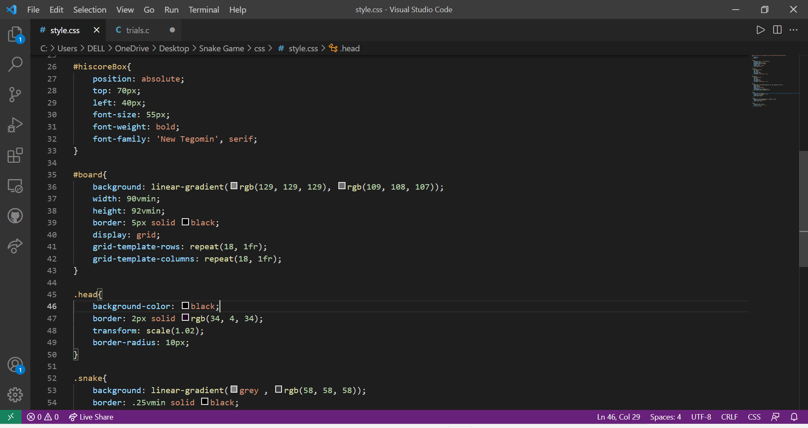
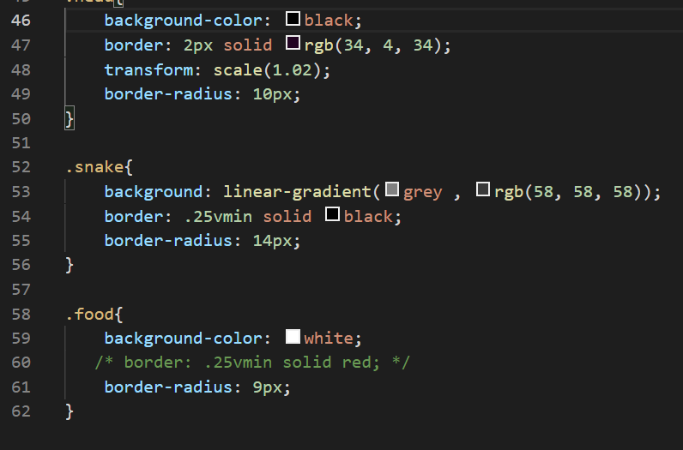

Slide 13
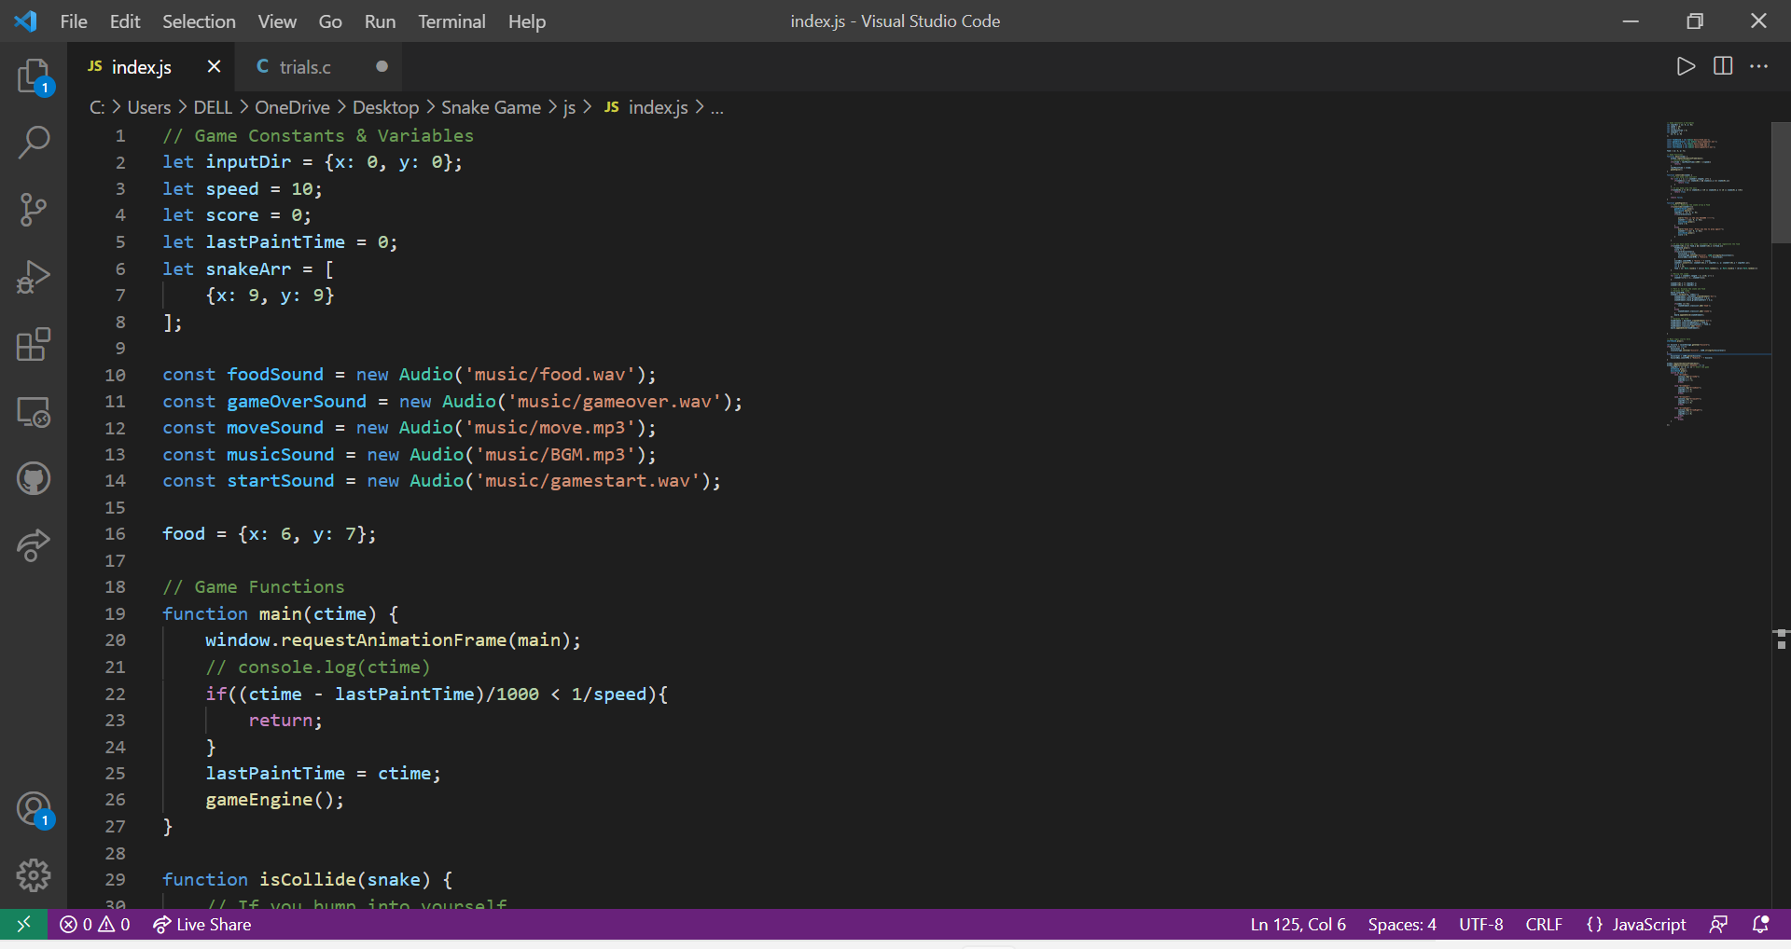
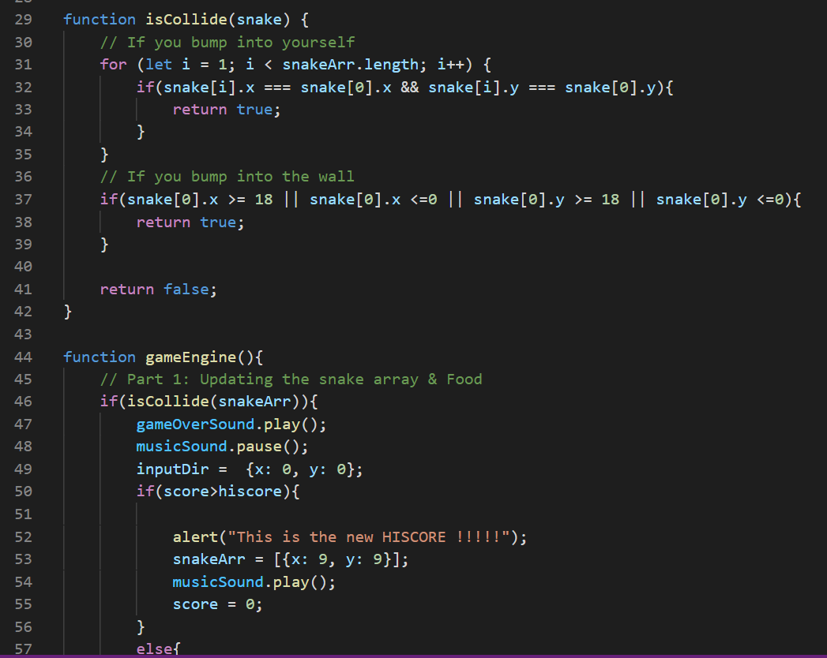
3. MAIN ALGORITHMIC PART

Slide 14
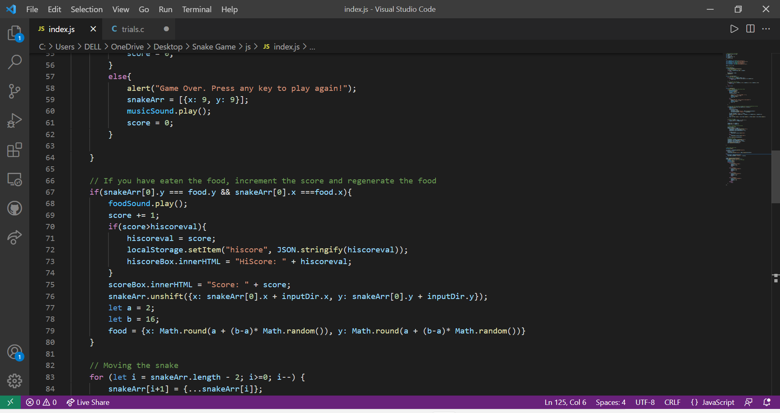

Slide 15
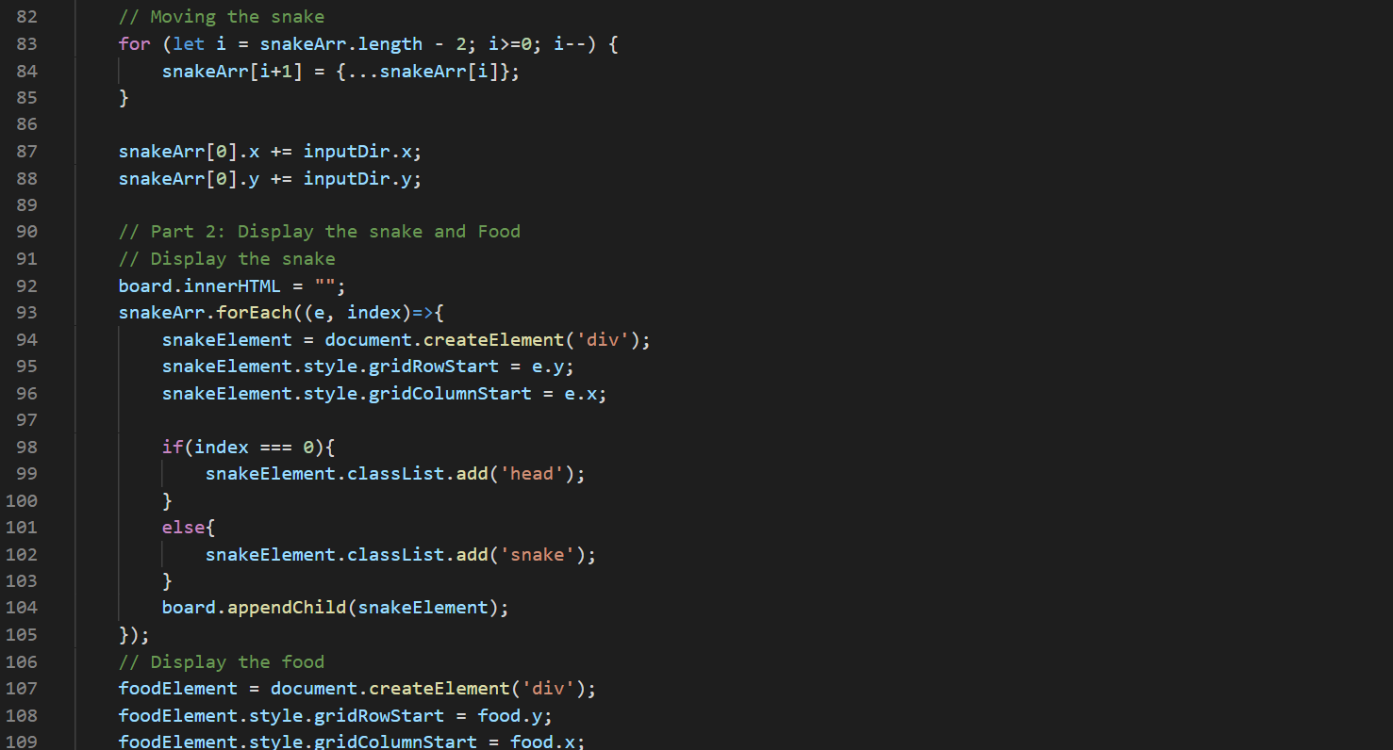

Slide 16
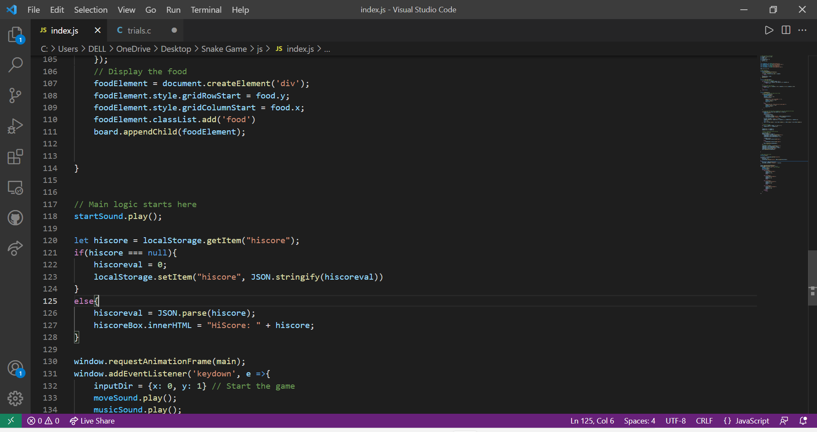

Slide 17
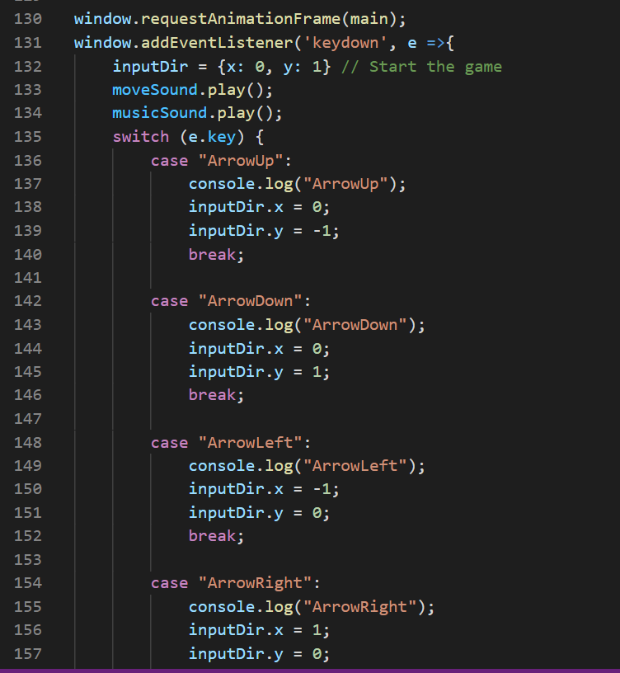
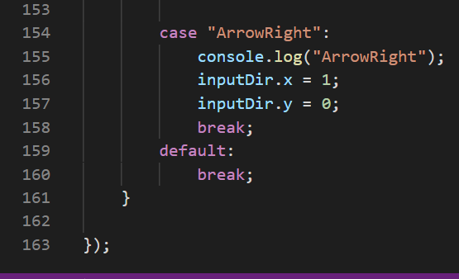

Slide 18
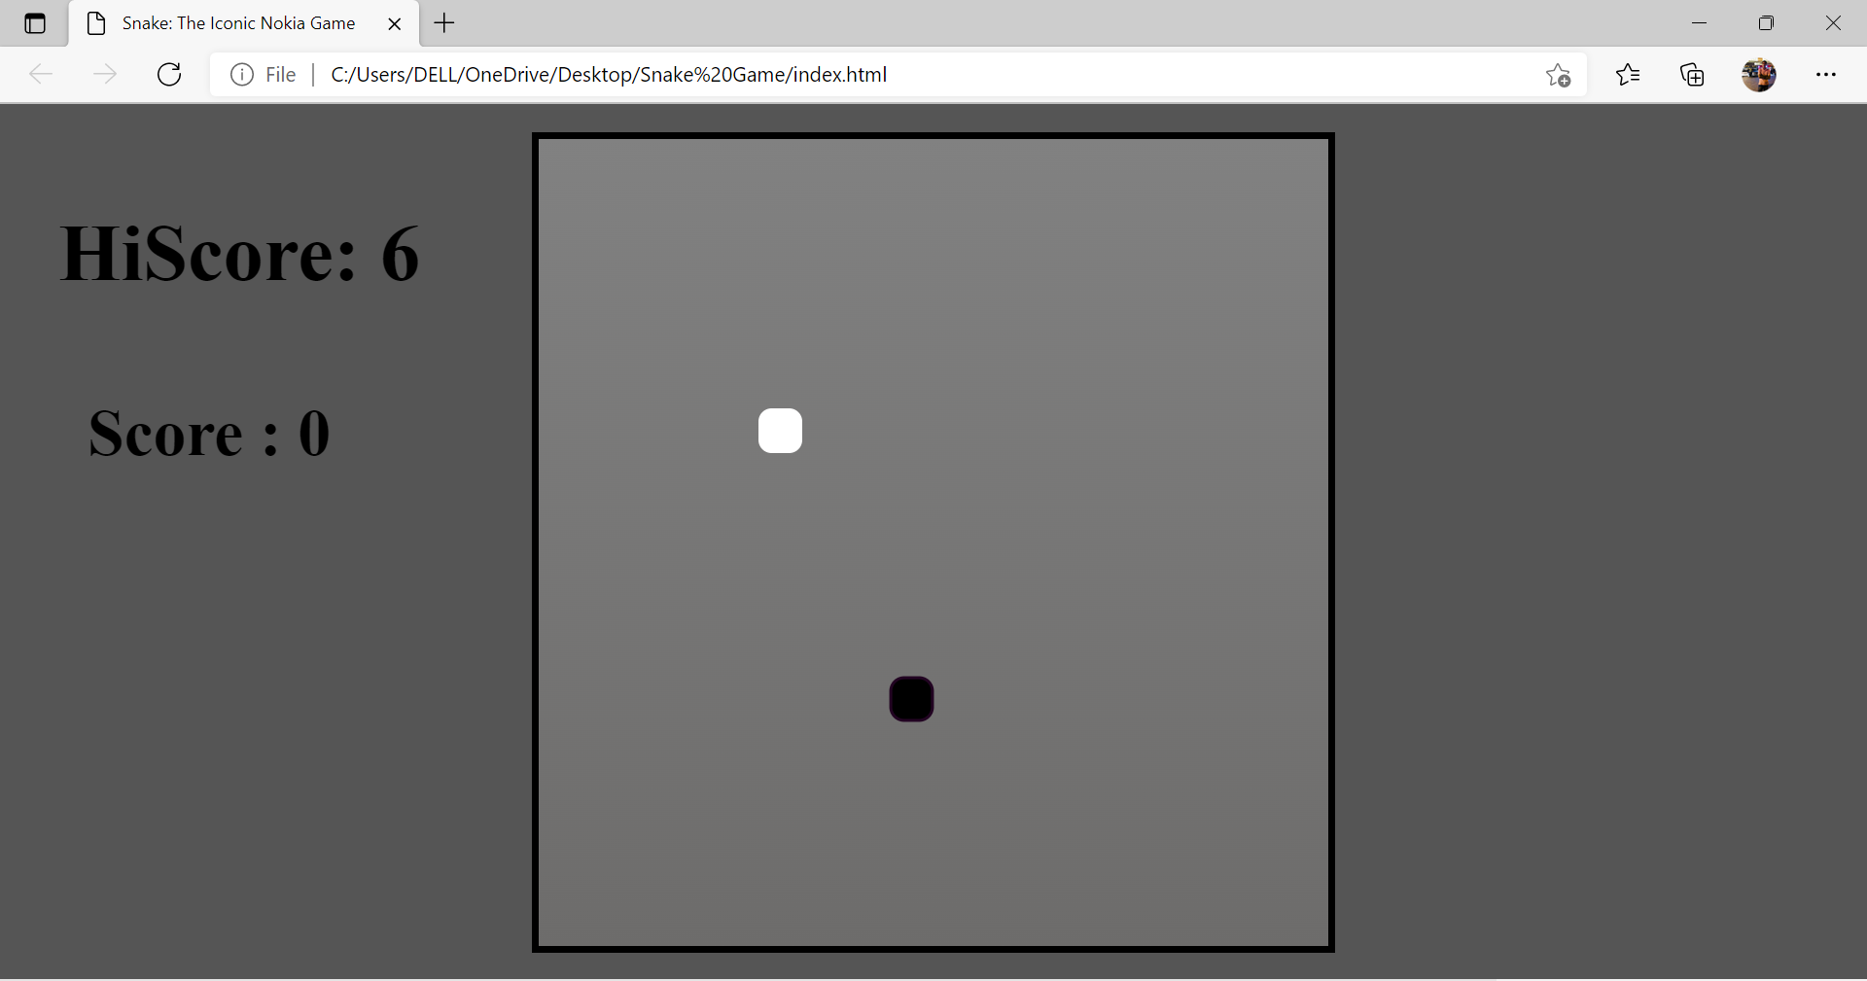
Outputs :

Slide 19
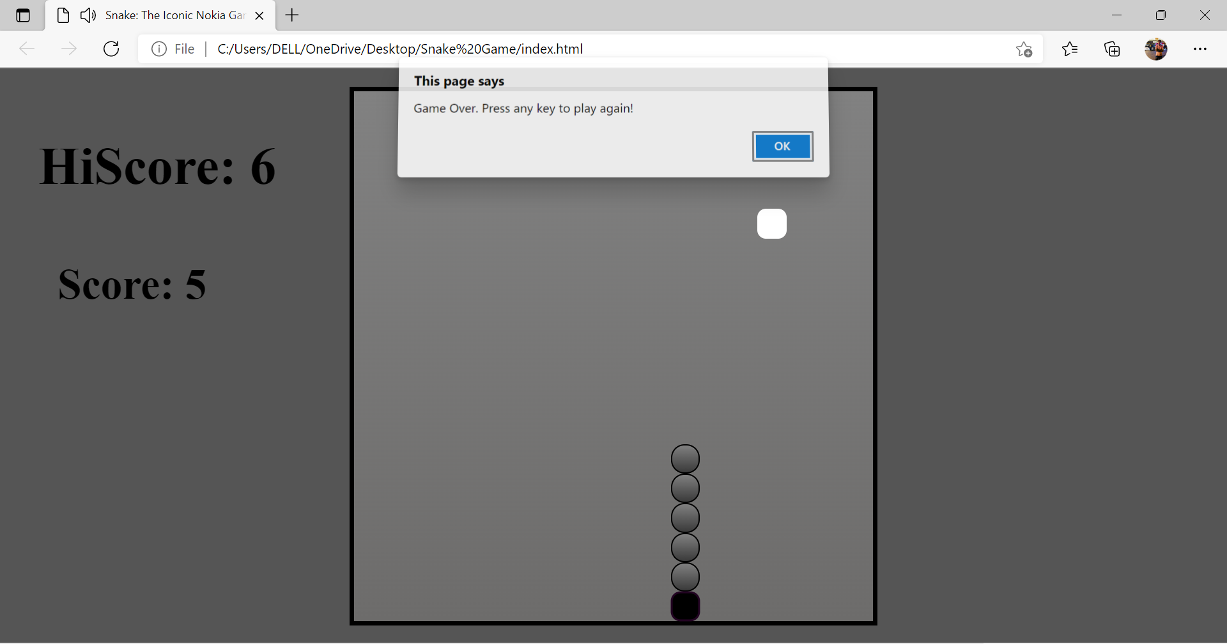

Slide 20
Future scope of the project
Our project has been made at a low level . We want to make it more advanced . So we have listed some point which we will modify in the future :
1. It can be made with good graphics.
2. We can add more options like Top 5 scores and Player Profile.
3. We can make it to be played Online.
4. Add more difficulties or other interesting things.
5. Add multiple food items simultaneously.
6. The functions set could be modified to feature enhanced detection capabilities and more advanced navigations options.

Slide 21
Conclusion
We have completed our Project SNAKE GAME and we learnt so many new things . We also obtained more experiences of WEBPAGE designing . Since it was the first time that we built a project using CSS , JS and HTML , a lot of problems were encountered during our work on the project.

Slide 22
References
Code with harry (you tube channel)
Stackoverflow
GeeksForGeeks
Tutorials Point

Slide 23
Thank you !

